Slide 1
IS 597 Final Project - Type 1
Critique and Improvement of Racing Strategies of Formula One
Group Members:
Andrew Mo, Ching-yun Huang, Tianci Zheng

Slide 2
Agenda
Original dataset & work description
Analysis and critique of the original work
Current progress of our improvement
Analysis
Code Implementation
Broader topic and application
Incomplete tasks

Slide 3
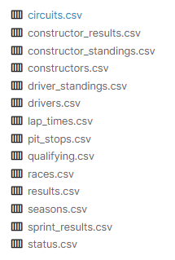
Original Dataset
Data source: Formula 1 (F1) World Championship (1950 - 2022)⁽¹⁾
A comprehensive dataset including circuits, results, races, seasons, etc.
Compiled from Ergast Developer API ⁽²⁾
Previous work focused on pit_stops.csv, results.csv, and races.csv
Notes:
*Kaggle: https://www.kaggle.com/datasets/rohanrao/formula-1-world-championship-1950-2020

Slide 4
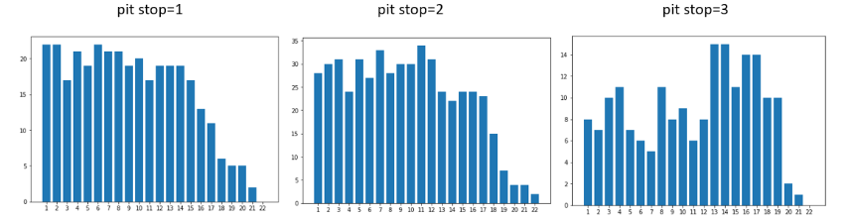
Original Work⁽³⁾
Hypothesis 1:
Less pit stops gives the driver better rank in each race.
“In these three bar charts, we can see there is not strong relationship between pit stop counts and positions.”

Slide 5
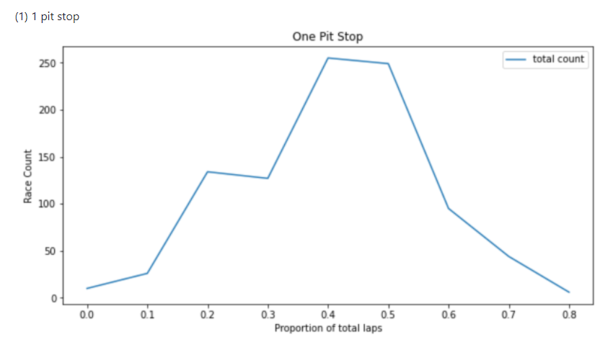
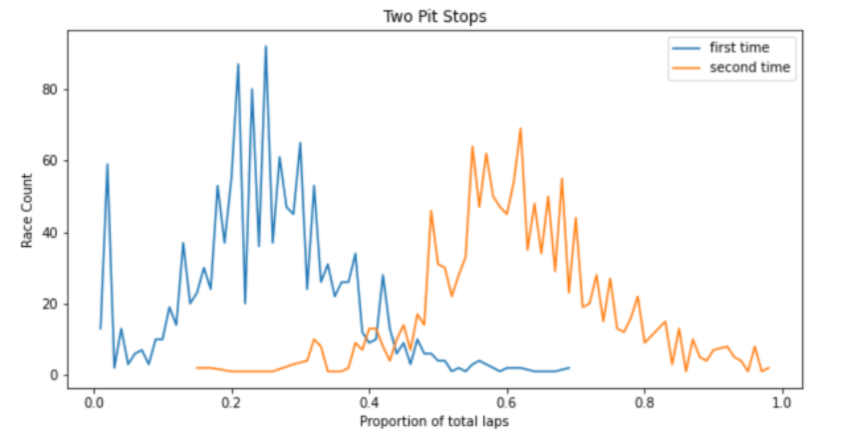
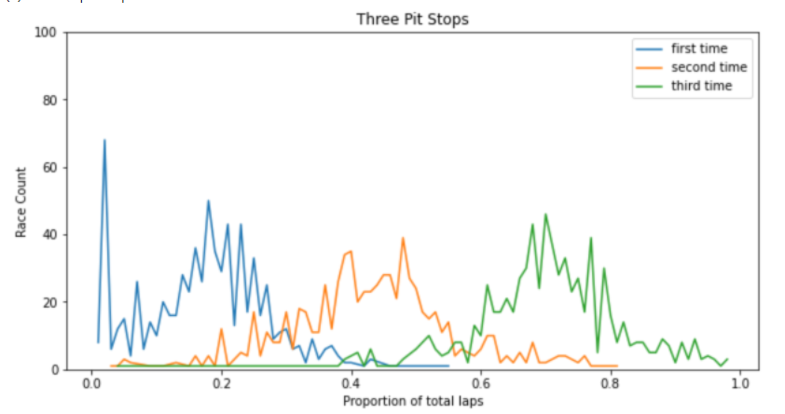
Original Work
Hypothesis 2:
Laps of the each pit stop times should be similar for better tire usage.
“We don't have strong evidence to reject the hypothesis 2 when the team pit stop times smaller than 3 times”

Slide 6
Critique - Original Analysis
Hypotheses Design
The first hypothesis’ graphic is inconsistent with the results
The second hypothesis is unclear and confusing
Hypotheses Tests
No substantial statistical methods
Results & Visualization
No comprehensive results
Lack of descriptions on data visualization

Slide 7
Critique - Original Coding
Poor documentation
Missing end-user instructions
Low-quality docstrings
Redundant and unnecessary functions
read_data, delete_data, df_group_plot
Low modularity
Main function includes too many lines of unorganized code
Prevent re-usability

Slide 8
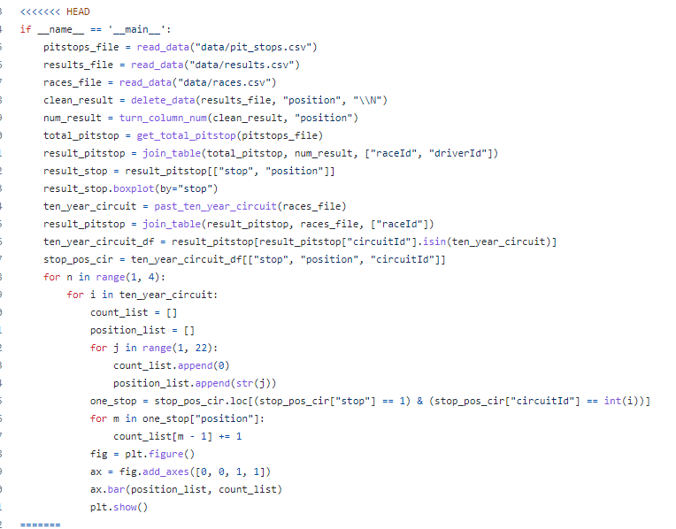
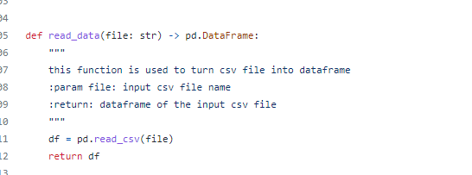
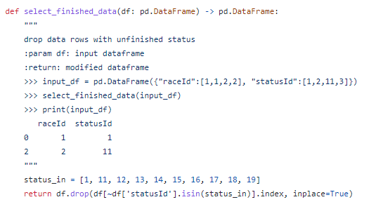
Examples of Coding Issues

Slide 9
Improvement
Analysis
Correct and improve existing hypotheses
Propose new hypotheses based on the existing dataset
Propose new topic and additional hypotheses on additional dataset & data source
Introduce statistical testing (Mann-Whitney U, T test)
Readme file
Code Implementation
Project Repo: https://github.com/TianciZheng/2022Spring_Finals
Comprehensive docstrings and doctests (working)
High Modularity and reusability
Efficiency techniques (working)

Slide 10
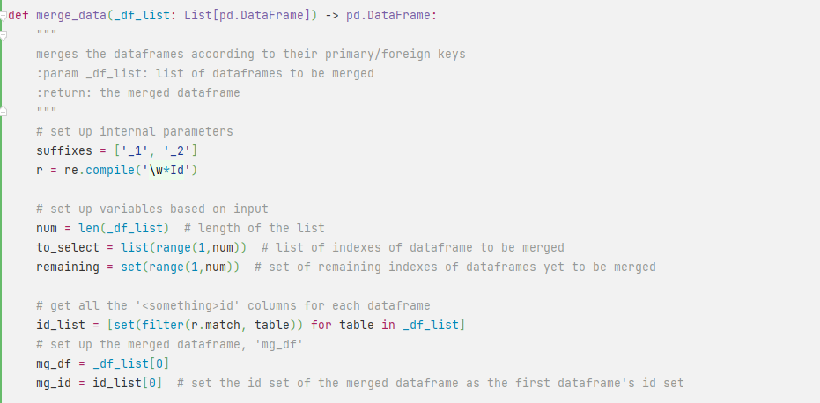
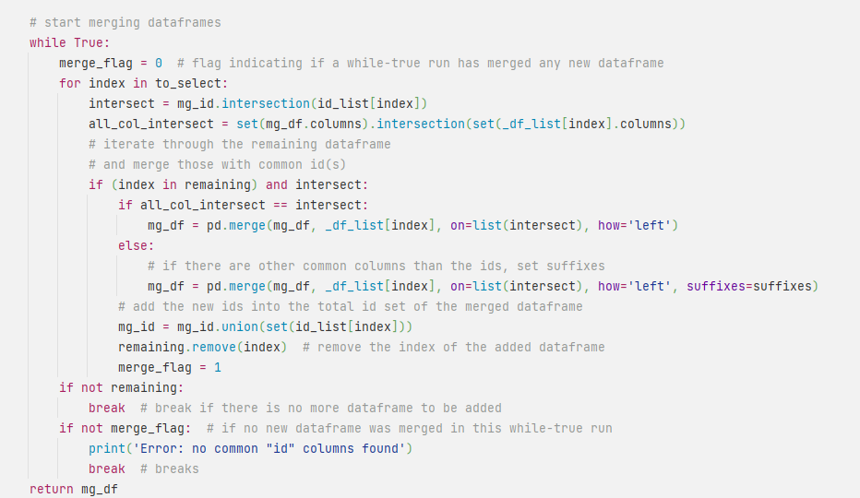
Coding Demo

Slide 11
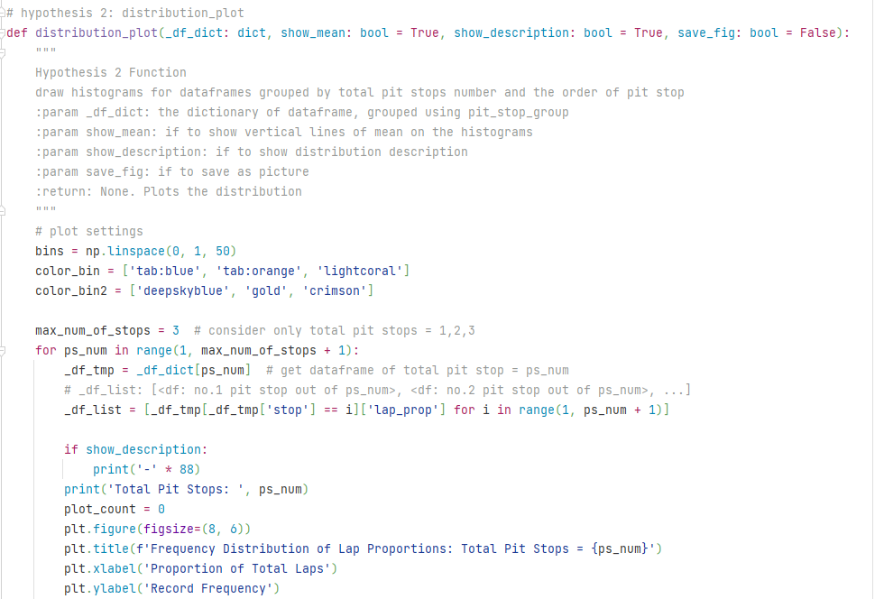
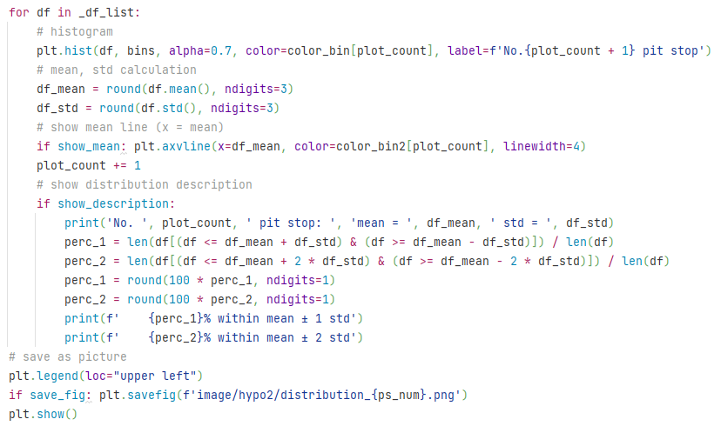

Slide 12
Our Analysis - Strategies in F1 Racing
New and Improved Hypotheses
Pit Stop Strategy
Hypotheses
Fewer pit stops give the driver a better rank in each race
The pit stops are evenly distributed
Evenly distributed pit stops give better race results
Racing Speed Strategy
Hypothesis
The distribution of lap time in a race has impact on the driver’s rank

Slide 13
Pit Stop Strategy
Data Grouping
Hypotheses
Fewer pit stops give the driver a better rank in each race
The pit stops are evenly distributed
Evenly distributed pit stops give better race results

Slide 14
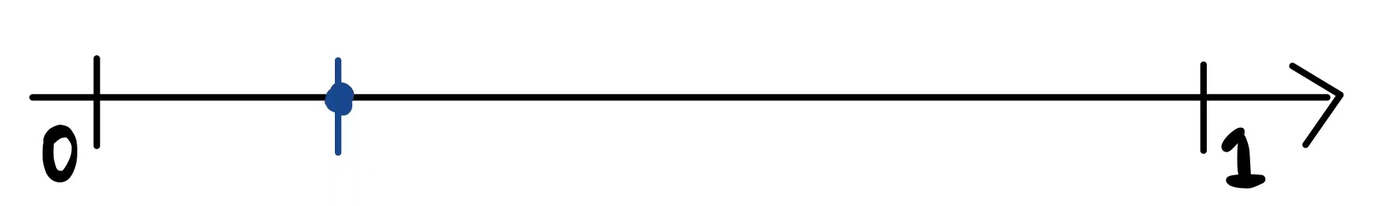
Data Example
 | raceID | driverID | Pit No. | Total Pit Stop | Lap Proportion
e.g. | 100 | 222 | 1 | 3 | 0.2
Data Grouping
Type A: Consider lap prop. of each pit stop as the independent individual variable
How someone stops in the <i th> pit out of the total <N> pits
Type B: Consider the positions of pit stops by each driver in each race as a whole
How someone stops all the pit stop in one entire race
Notes:
compare 3 variables individual pit effect on the ranking
compare signal variable the 3 pit records as a whole instead individual pit effect

Slide 15
Pit Stop Strategy
Hypothesis 1:
Fewer pit stops give the driver a better rank in each race

Slide 16
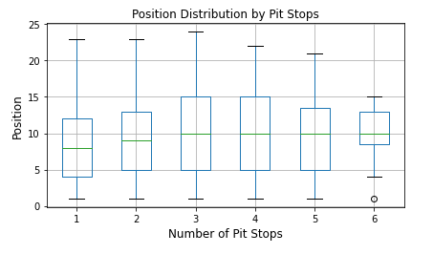
Hypothesis 1
Type B: Each driver’s ALL pit records in each race
After updating dataset to 2022 and improving the code, we obtained
the results that are opposite to the original analysis.

Slide 17
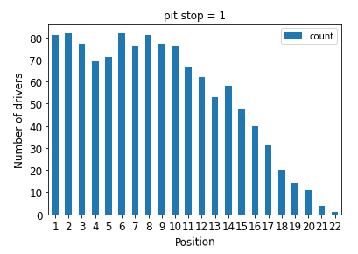
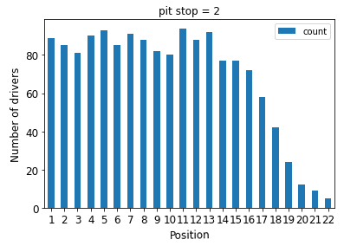
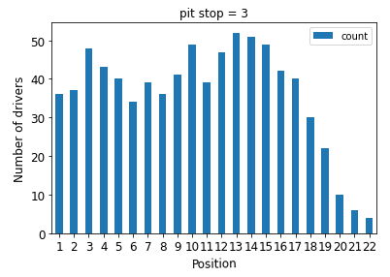
Hypothesis 1
The bar charts focus on drivers taking 1, 2 or 3 pit stops, and the analysis results are similar to the boxplot. Hypothesis 1 will not be rejected.
For drivers taking 1 pit stop, the distribution of rank concentrates on rank 1 to 10.
For drivers taking 2 pit stop, the distribution of rank concentrates on rank 1 to 13
For drivers taking 3 pit stop, the distribution of rank concentrates on rank 10 to 15.

Slide 18
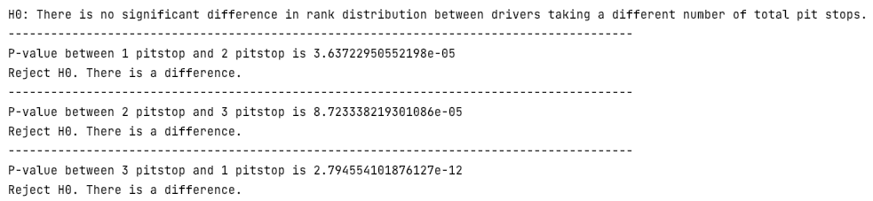
Hypothesis 1
To strengthen the analysis result, we conducted the Mann-Whitney U test to verify whether there is a significant difference in rank distribution between drivers taking a different number of total pit stops. The analysis results show there is a difference.

Slide 19
Hypothesis 1: Fewer pit stops give the driver a better rank in each race
Results Summary:
When the number of total pit stops of each driver is less than or equal to 3, taking less stops brings driver a higher rank.
For drivers taking 1, 2 or 3 pit stops, there is a significant difference in rank distribution between drivers taking a different number of total pit stops.
Conclusion:
For drivers taking 1, 2 or 3 pit stops, Hypothesis 1 will not be rejected.

Slide 20
Pit Stop Strategy
Hypothesis 2:
The pit stops are evenly distributed through time

Slide 21
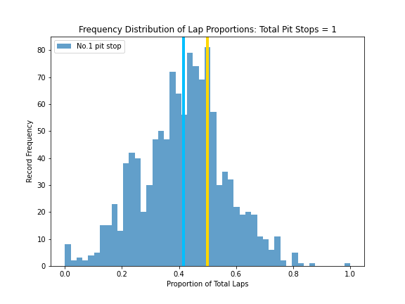
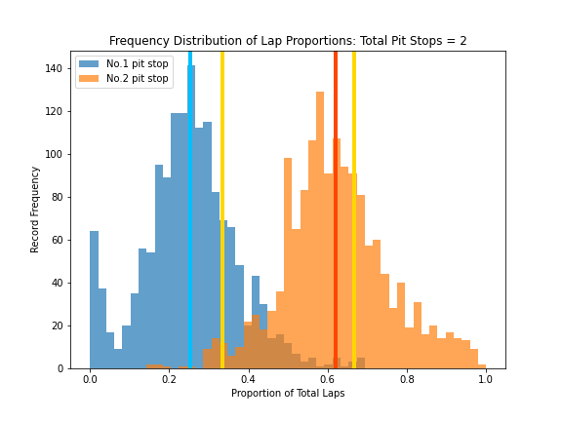
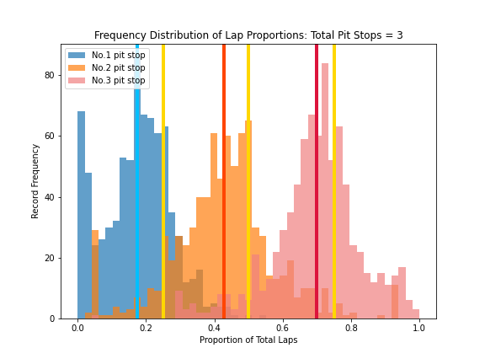
Hypothesis 2
Type A: Each driver’s EACH pit record in each race
(Results Overview)

Slide 22
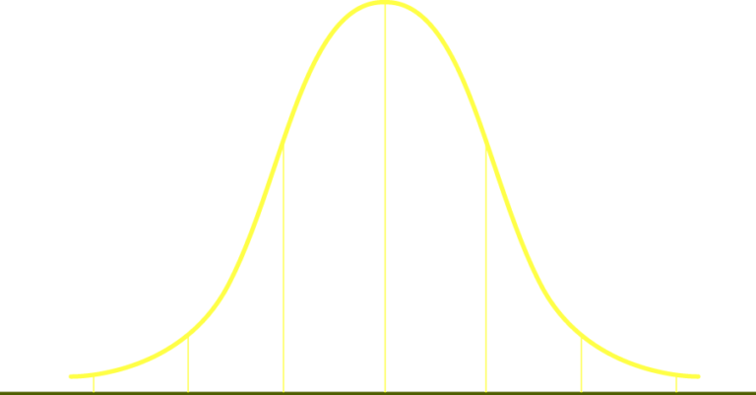
Hypothesis 2
Each Group is approximately distributed Normally
All Groups deviate from the expected
‘Evenly Distributed Points (½, ⅓, ⅔, …)’
1/2
1/3
2/3
Mean
Mean
Mean
mean = 0.416 std = 0.147
T Test p value=2.08e-74
mean = 0.252 std = 0.118
T Test p value=4.28e-129
mean = 0.62 std = 0.134
T Test p value=1.97e-39

Slide 23
Hypothesis 2
1/4
2/4
3/4
Mean
mean = 0.174 std = 0.098
T Test p value=9.55e-84
mean = 0.427 std = 0.155
T Test p value=6.38e-37
mean = 0.698 std = 0.13
T Test p value=5.45e-28

Slide 24
Hypothesis 2: The pit stops are evenly distributed through time
Results Summary:
The proportions of total laps when the drivers pit distribute symmetrically around the mean, and are similar to normal distributions.
The p values of the one-sample T Tests show that the proportions are not distributed around the evenly dividing points (½, ⅓, ⅔, …).
Conclusion:
Reject the null hypothesis. The pit stops are NOT evenly distributed through time

Slide 25
Pit Stop Strategy
Hypothesis 3:
Evenly distributed pit stops give better race results

Slide 26
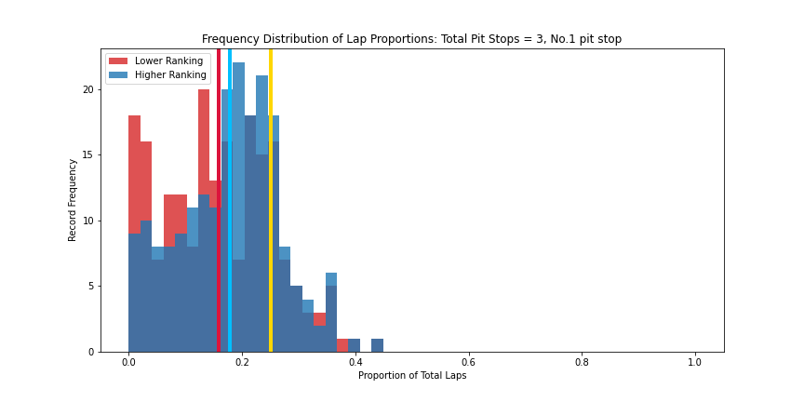
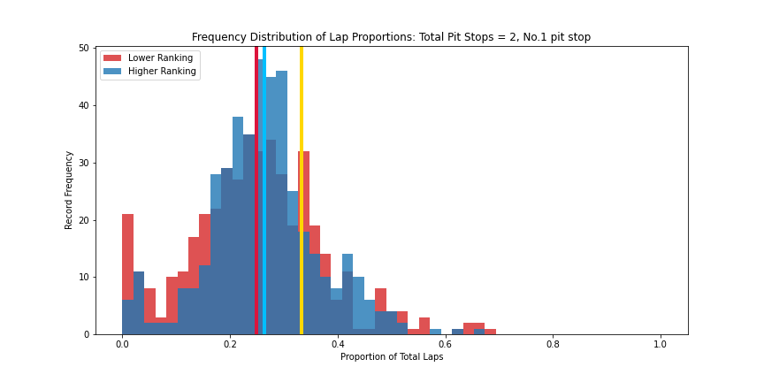
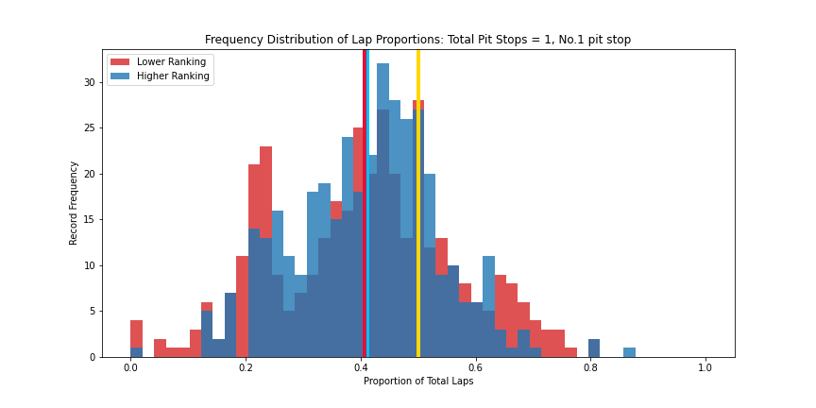
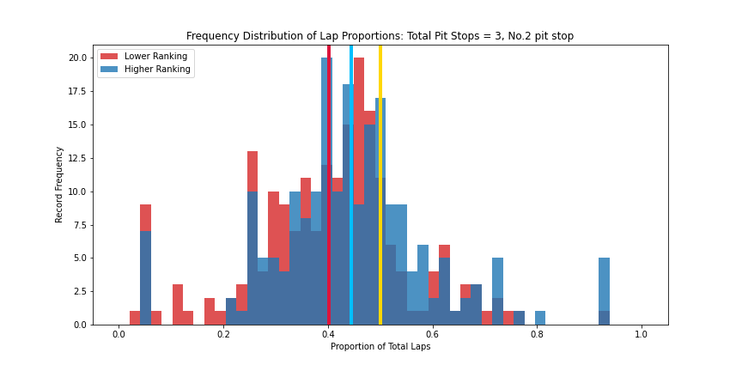
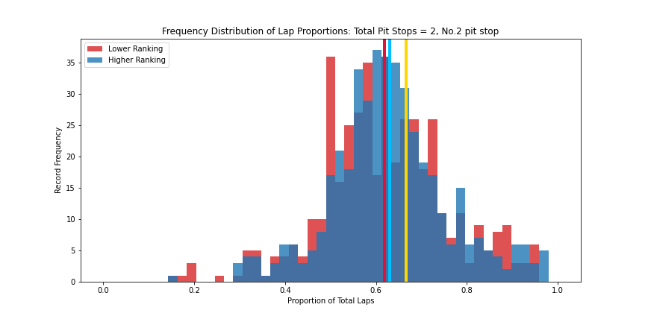
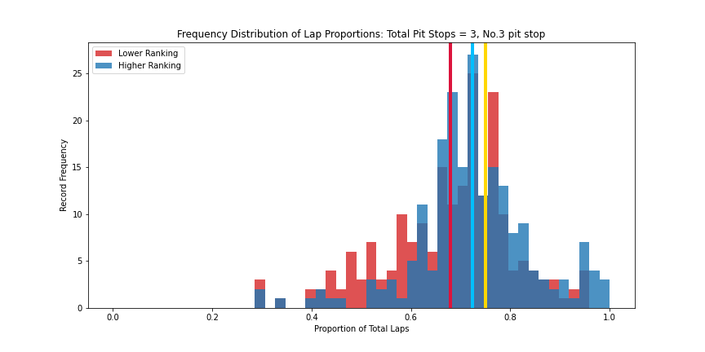
Hypothesis 3
Type A: Each driver’s EACH pit record in each race
(Results Overview)
Rank <= 5
Rank > 5

Slide 27
Hypothesis 3
Total Pit Stop = 1
Pits of Higher ranking records are overall CLOSER to the ‘Evenly Distributed Points (½, ⅓, ⅔, …)’
But the difference is not statistically significant
Mann Whitney U Test
p value=0.612
No. 1 Pit
1/2

Slide 28
Hypothesis 3
Total Pit Stop = 2
Pits of Higher ranking records are overall CLOSER to the ‘Evenly Distributed Points (½, ⅓, ⅔, …)’
Only the difference of the FIRST Pit is statistically significant
1/3
Mann Whitney U Test
p value=0.062
No. 1 Pit
Mann Whitney U Test
p value=0.217
No. 2 Pit
2/3

Slide 29
Hypothesis 3
Total Pit Stop = 3
Pits of Higher ranking records are overall CLOSER to the ‘Evenly Distributed Points (½, ⅓, ⅔, …)’
ALL differences are statistically significant (Total = 3)
No. 1 Pit
Mann Whitney U Test
p value=0.045
No. 2 Pit
Mann Whitney U Test
p value=0.045
No. 3 Pit
Mann Whitney U Test
p value=0.045

Slide 30
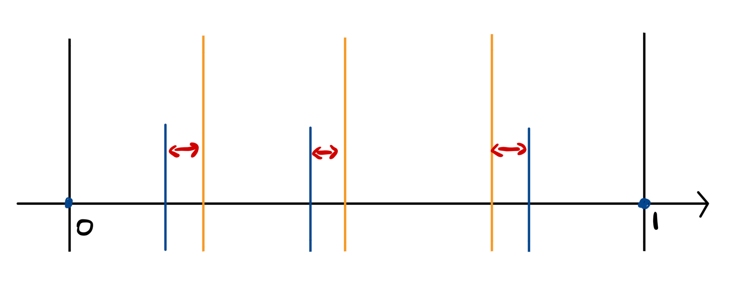
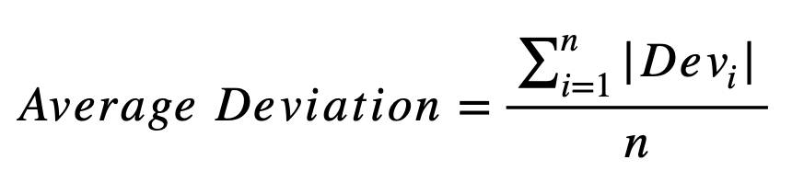
Hypothesis 3
Type B: Each driver’s ALL pit records in each race
Example: Total Pit Stop = 3
Alternative Method:
Type B Data Grouping
A different measure for Deviation:
Deviation no. 1
Dev no. 2
Dev no. 3
1/4
2/4
3/4
-
1st pit
2nd pit
3rd pit

Slide 31
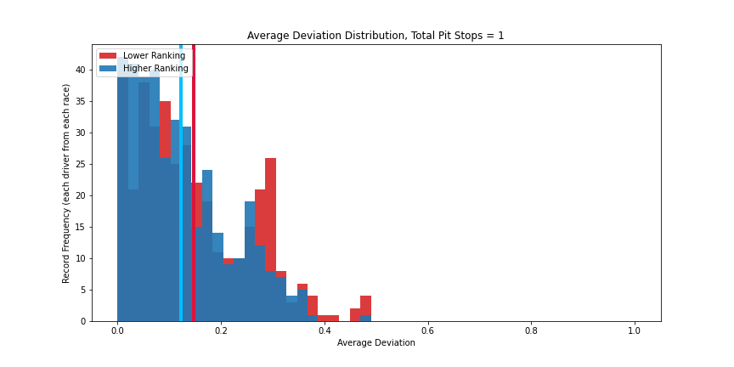
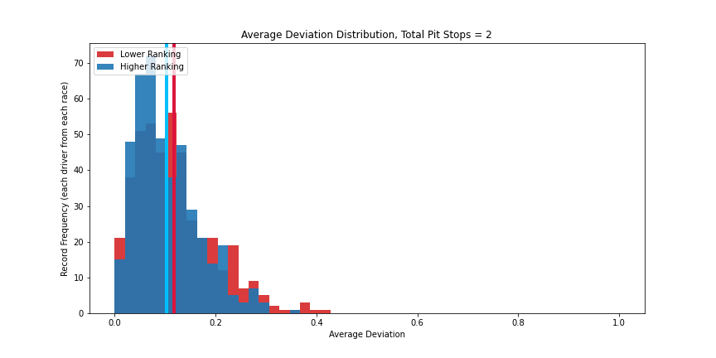
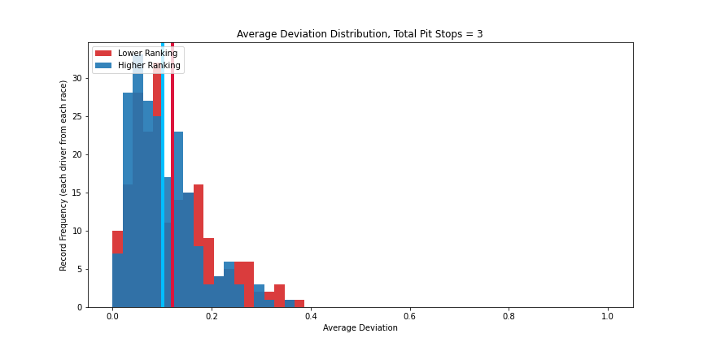
Hypothesis 3
Pits of Higher ranking records are overall CLOSER to the ‘Evenly Distributed Points (½, ⅓, ⅔, …)’
ALL differences are statistically significant (Total = 1,2,3)
Average Deviation
Total Pit Stop = 1
Mann Whitney U Test
p value=0.002
Total Pit Stop = 2
Mann Whitney U Test
p value=0.006
Total Pit Stop = 3
Mann Whitney U Test
p value=0.022
Notes:
closer to zero, closer to the idea distributed lap proportion,

Slide 32
Hypothesis 3: Evenly distributed pit stops give better race results
Results Summary:
The average deviations of the pit timings are all relatively lower in the data groups with higher ranking, compared with the lower ranking group
The p values of the Mann-Whitney U Tests are all lower than the significant level of 0.05, indicating the differences are statistically significant.
Conclusion:
Accept the null hypothesis: Evenly distributed pit stops give better race results
i.e. If the driver pits closer to these points (½, ⅓, ⅔, …), it will be more likely to get higher ranking in a race.

Slide 33
Racing Speed Strategy
Hypothesis 4:
The distribution of time spend on each lap
in a race has an impact on the driver’s final rank

Slide 34
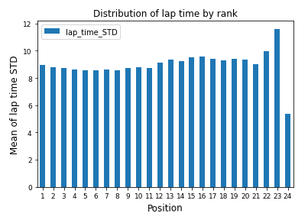
Hypothesis 4
We calculated the standard deviation of time spent on each lap for every driver in a race, and show the mean standard deviation by rank in all races.

Slide 35
Hypothesis 4: The distribution of time spend on each lap in a race has impact on the driver’s final rank
Results Summary:
The mean standard deviation of each rank has no obvious difference.
Conclusion:
We reject the null hypothesis. The distribution of time spend on each lap in a race has no impact on the driver’s final rank.

Slide 36
Work in Progress
Hypothesis 4 (statistical support)
Analysis on new data source (Formula E)
Overlapping: constructor/team
constructor (Ferrari & Mercedes Benz are the leading manufacturers in F1)
Doctests
Efficient techniques
Readme file

Slide 37
Q & A

Slide 38
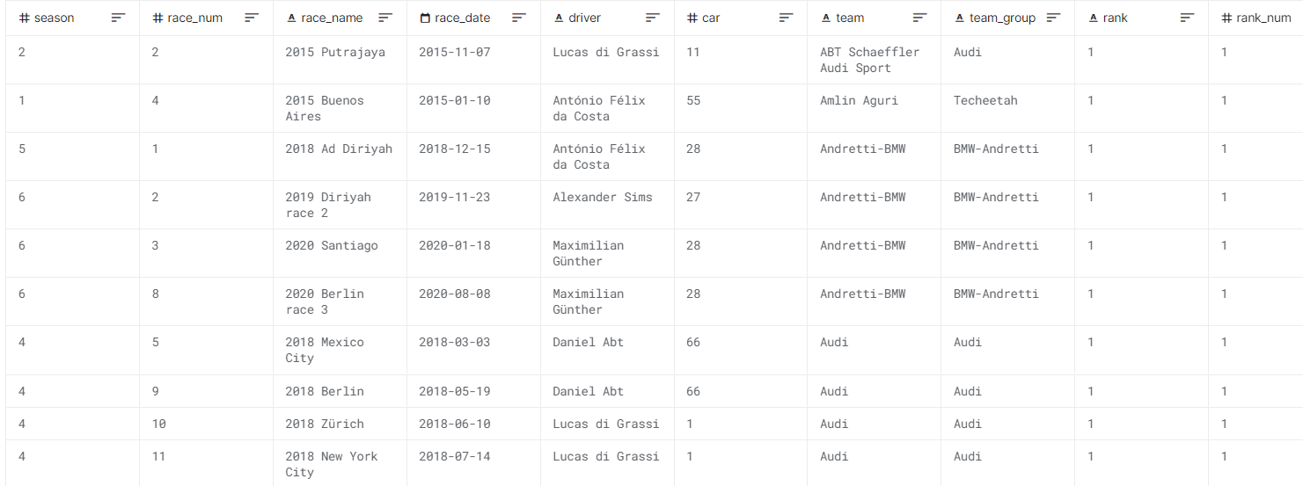
Appendix - Formula E Dataset

Slide 39
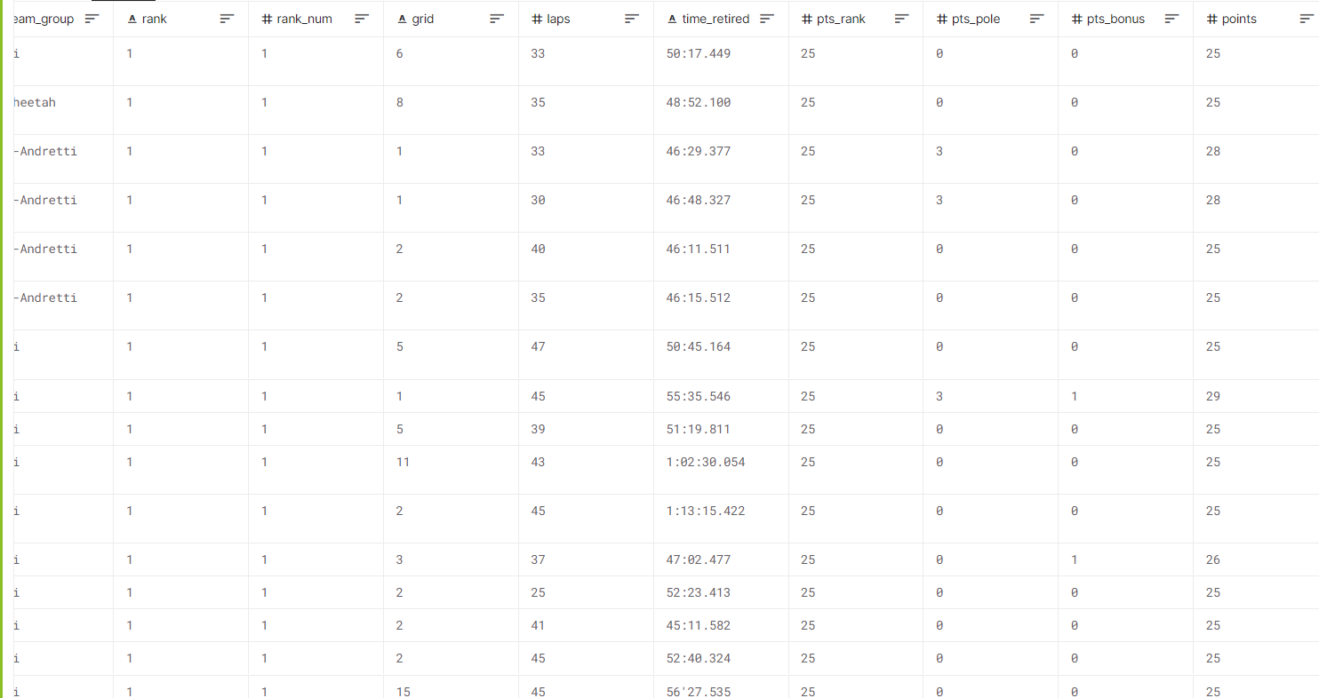
Appendix - Formula E Dataset (Cont.)

Slide 40
References
Vopani. Formula 1 World Championship (1950 - 2022). https://www.kaggle.com/datasets/rohanrao/formula-1-world-championship-1950-2020
Ergast Developer API. http://ergast.com/mrd/
Ko-Mei Lin, Yi-Shiuan Ho, https://github.com/ho-yi-shiuan/2021_Spring_finals

